Slide 1
OstraCam II IDR
Paul Killam, Oliver Thio, Christina Lim
Notes:
Introductions by all

Slide 2
OstraCam I
The purpose last year was to design a system that is able to record low-light video of bioluminescent ostracods and document data about the oceanic environment at the time
Data saved to be analyzed later
Issues they ran into on the field
Camera re-calibration and maintenance
Lack of feedback from device
Ease of use by someone in full diving gear (IR remote, etc..)
Poor quality from the cameras in-situ
Notes:
Presenter:

Slide 3
Notes:
Presenter: Oliver? (since you met with Caio last to better understand the setup)

Slide 4
Goals for OstraCam II
How we’re improving it
Transitioning to a more appropriate microcontroller
Adding additional sensors for more data collection
Working on distortion issues with the cameras
Notes:
Presenter:

Slide 5
Team members
Paul Killam - Team lead, Firmware, Computer Vision
Oliver Thio - Software, MATLAB, Computer Vision
Christina Lim - Hardware, DxDesign
Notes:
Presenter: Paul

Slide 6
What we’re keeping
Inertial Sensor: ADIS16300AMLZ SPI interface
pH Sensor: EZO pH sensor UART/i2C interface
Salinity Sensor: EZO Conductivity Circuit UART/i2C interface
LCD Display: MCOC2002AWMRE Parallel interface
Video decoder: TVP5158IPNP i2C/parallel interface
2 Low-light cameras: Watec WAT-910HX
SD Card
Waterproof casing
*Data recorded to be stored on SD card
Notes:
Presenter: Christina

Slide 7
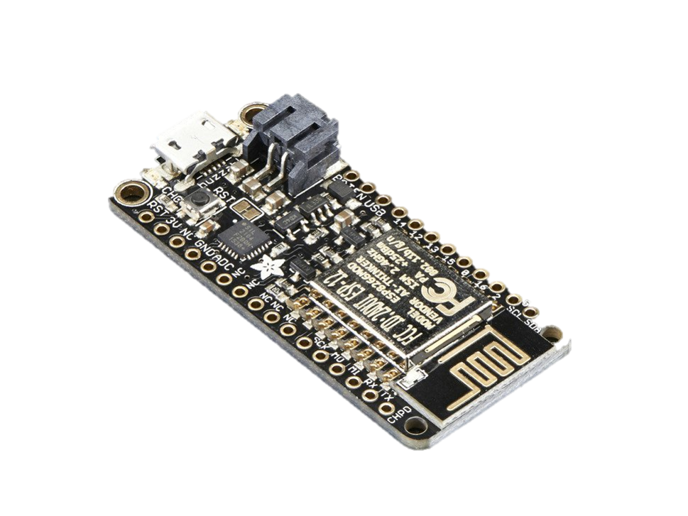
What we’re changing
New microcontroller: ESP8266
Reduces programming complexity of LPC 4088
Arduino compatible
Has RTC
Adafruit feather HUZZAH development board with USB programming and battery charging
$15.95
Notes:
Presenter: Christina

Slide 8
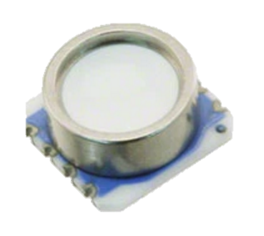
What we’re adding
Underwater pressure and temperature sensor
MS5803-30BA
i2C/SPI interface
0-30 bar (0-29.6 atm)
Digikey: $29.03
Notes:
Presenter: Christina

Slide 9
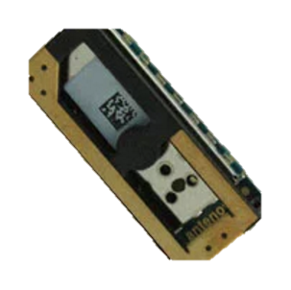
What we’re adding
GPS Module
Antenova M10382-A1
UART/SPI/i2C interface
$19.24
Notes:
Presenter: Christina

Slide 10
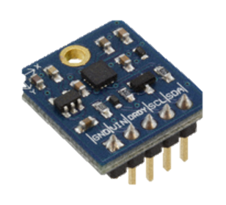
What we’re adding
Compass
Parallax 29133
i2C interface
$5.05
Notes:
Presenter: Christina

Slide 11
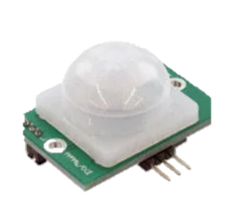
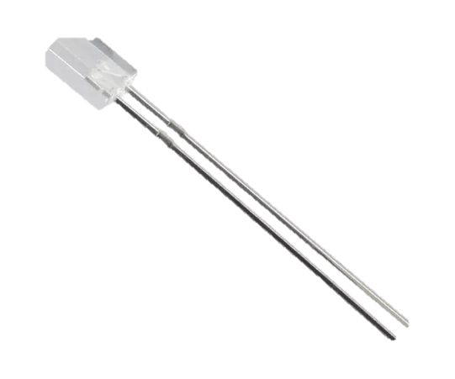
What we’re adding
Wireless infrared trigger
IR LED + Passive IR sensor
Trigger without opening waterproof case
IR LED: IR533C
Digikey: $0.42
PIR Sensor: 555-28027
Digikey: $12.99
Notes:
Presenter: Christina

Slide 12
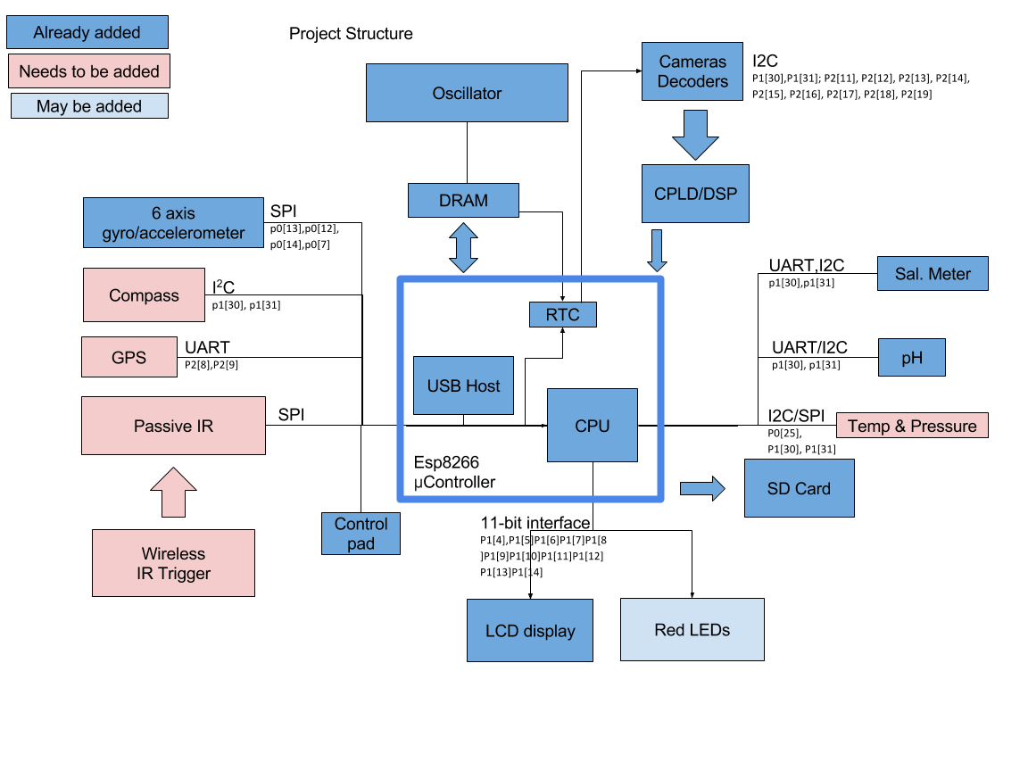
Block diagram of peripherals
Notes:
Presenter: Christina

Slide 13


Raw Footage from OstraCam I
Notes:
Presenter: Paul

Slide 14


Postprocessed Footage from OstraCam I
Notes:
Presenter: Paul

Slide 15
Software and firmware issues to be addressed this year
Recalibration for every data set due to bad 3D-printed camera mountings
Frame synchronization
Postprocessing fishbowl distortion correction
Sub-pixel interpolation to maximize image quality
3-D mapping
Notes:
Presenter: Paul (recalibration, frame sync, postprocessing, interpolation)

